Slide 1

How to get a job in NL
Notes:
aap

Slide 2
Content
Employment market
Where to search for jobs
How to search/ Social media recruitment trends
Questions
Notes:
aap

Slide 3
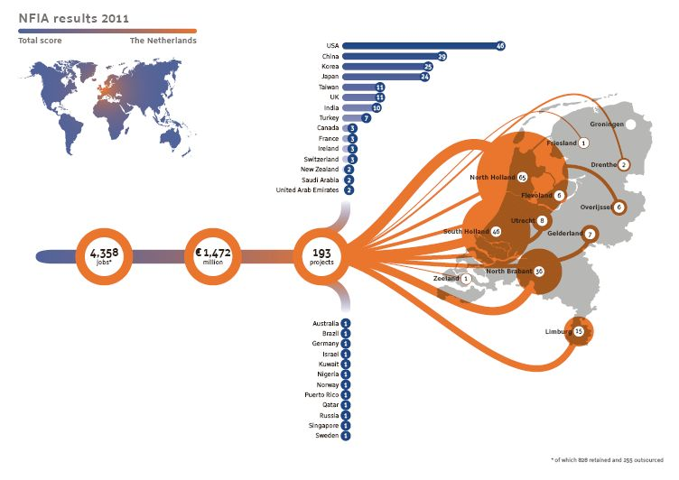
Employment market
Notes:
aap

Slide 4
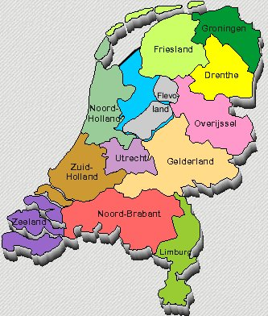
Employment market
Regional Profiles
Nothern Netherlands
East Netherlands
Province of Flevorland
Province of Utrecht
North Holland North
Amsterdam Metropolitan Area
Port of Amsterdam
West Holland
City of Rotterdam
Province of Zeeland
Province of North Brabant
Province of Limburg
Notes:
aap

Slide 5
Employment market
More than 6,300 foreign companies have established over 8,800 operations in the Netherlands.
2011:
Amsterdam Metropolitan Area:
118 new international companies
employment for 1,231 people
West Holland:
32 international companies
employment for 766 people
Notes:
aap

Slide 6
Where to search
Company careers sites
Recruitment agencies
Job boards
Job search engines
Online networking

Slide 7
Company career sites
Bizdirectories and company spot sites
World trade centers
Investement companies
Chambers of commerces

Slide 8
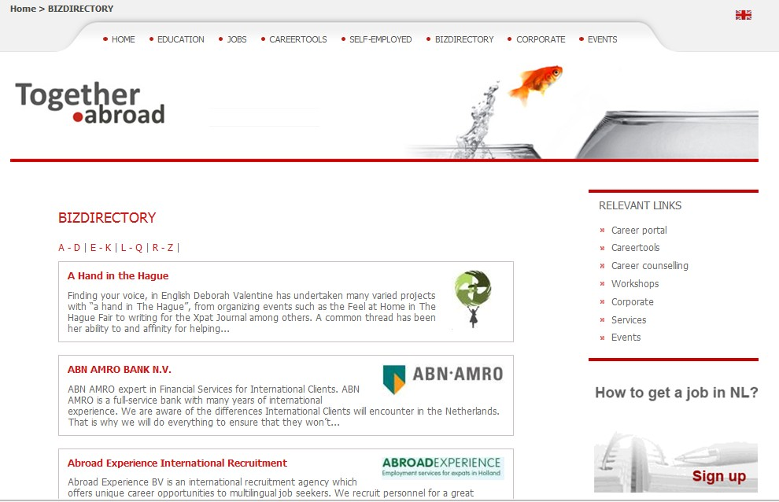
Company career sites

Slide 9
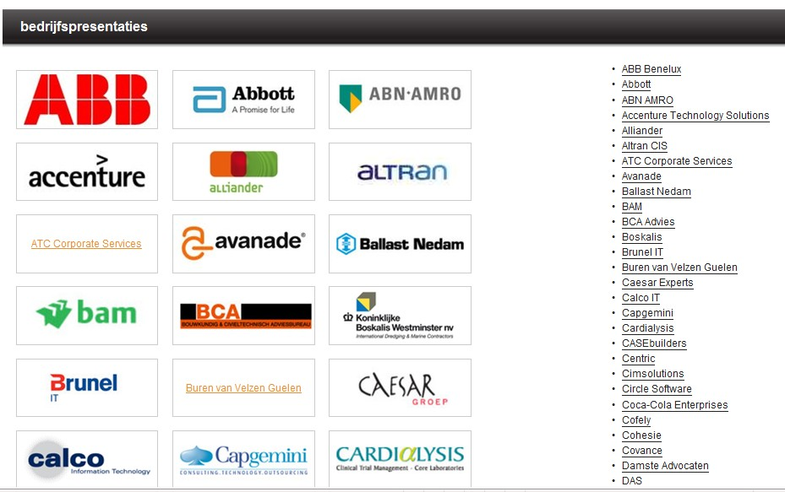
Company career sites
www.kiesjewerkgever.nl
Notes:
aap

Slide 10
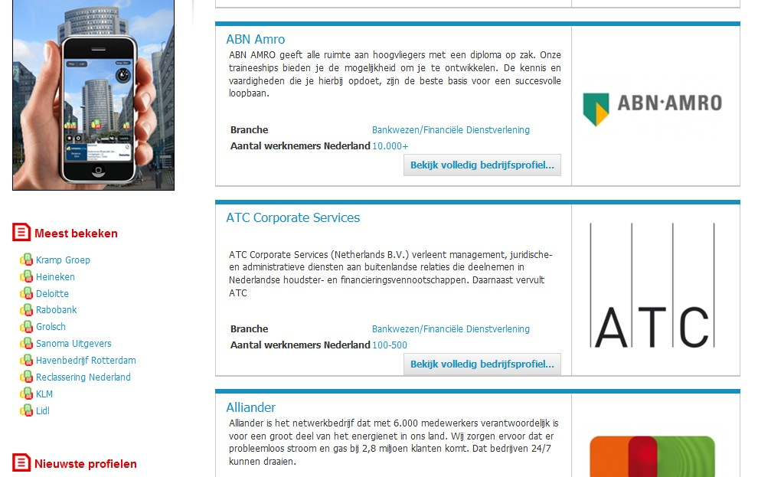
Company career sites
www.companyspot.nl
Notes:
aap

Slide 11
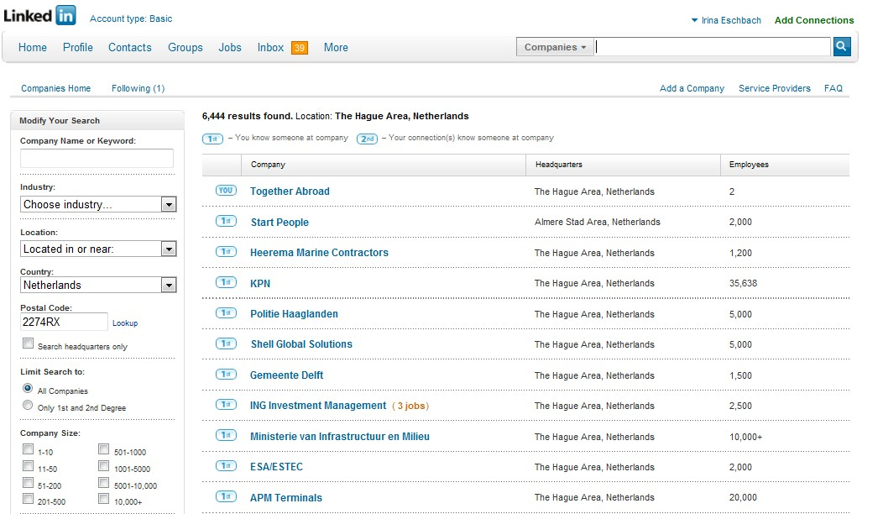
Company career sites
www.linkedin.com
Notes:
aap

Slide 12
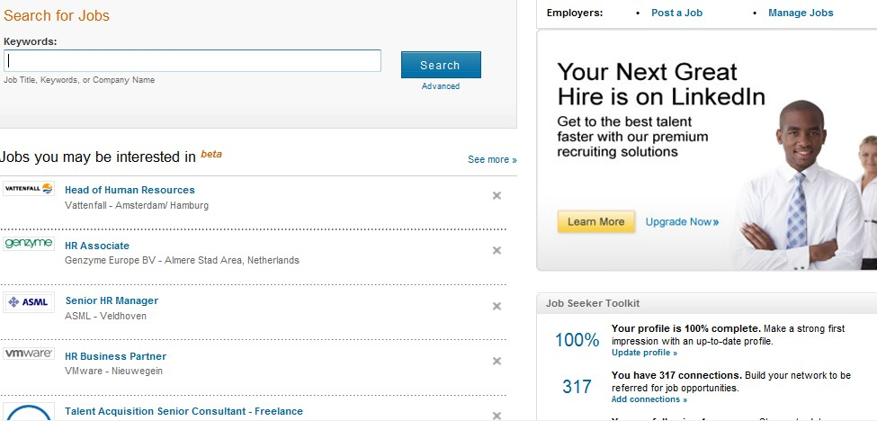
Company career sites
www.linkedin.com
Notes:
aap

Slide 13
Recruitment agencies

Slide 14
Recruitment agencies

Slide 15
Commercial Jobsites: Job Boards
General /niche
CV database
Data protection and privacy
Search agents
RSS Job feeds

Slide 16
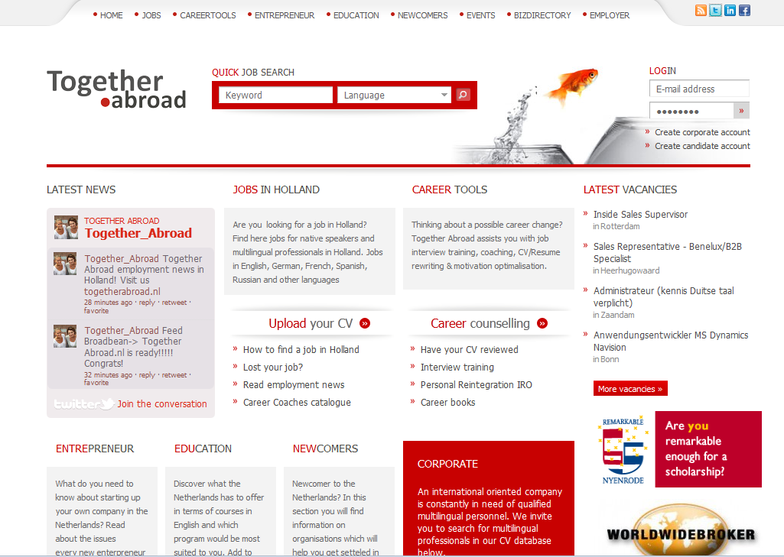
Commercial Jobsites: Job Boards

Slide 17
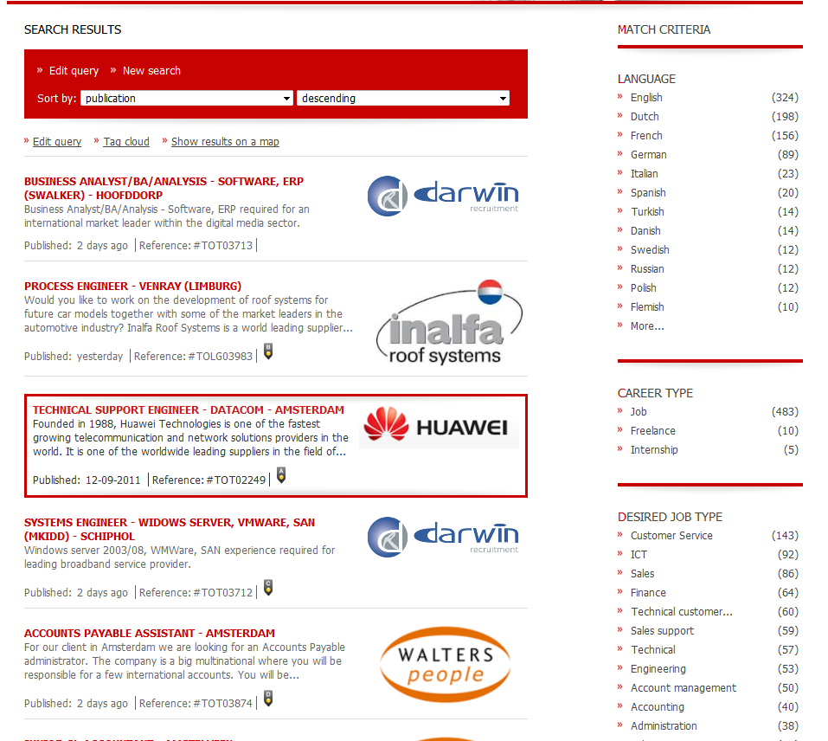
Commercial Jobsites: Job Boards

Slide 18
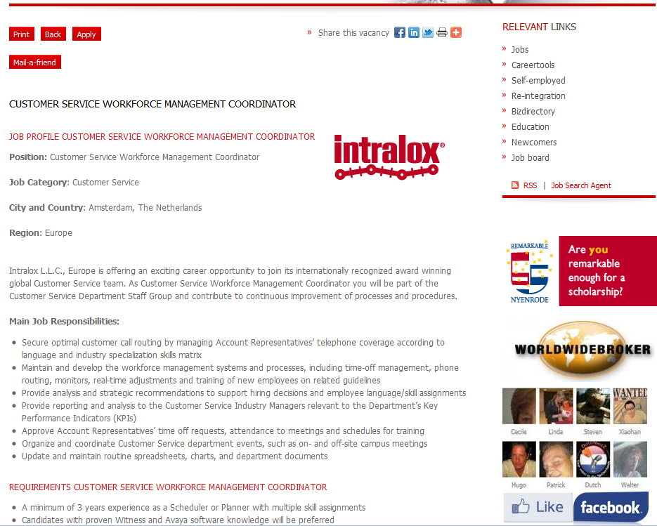
Commercial Jobsites: Job Boards

Slide 19
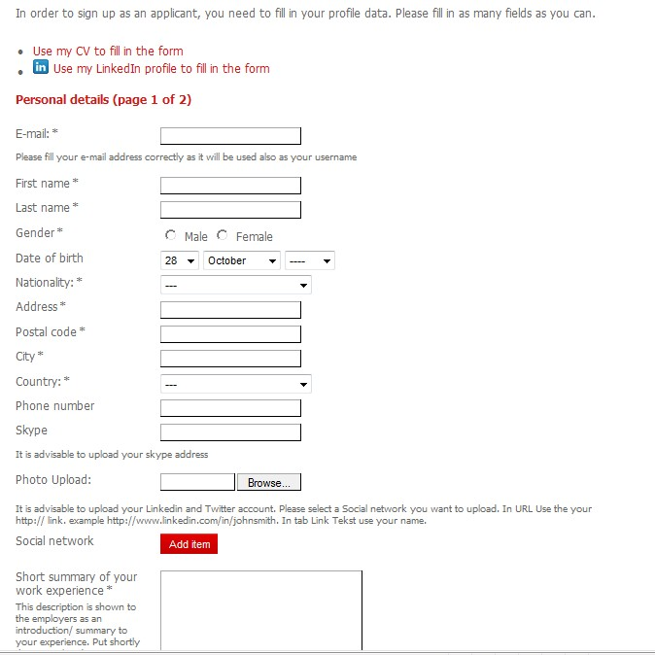
Commercial Jobsites: Job Boards

Slide 20
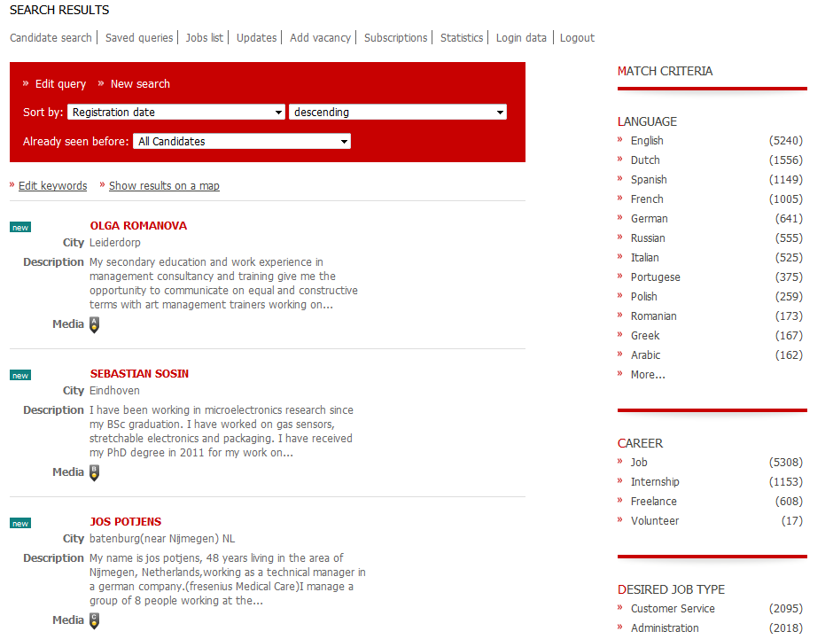
Commercial Jobsites: Job Boards

Slide 21
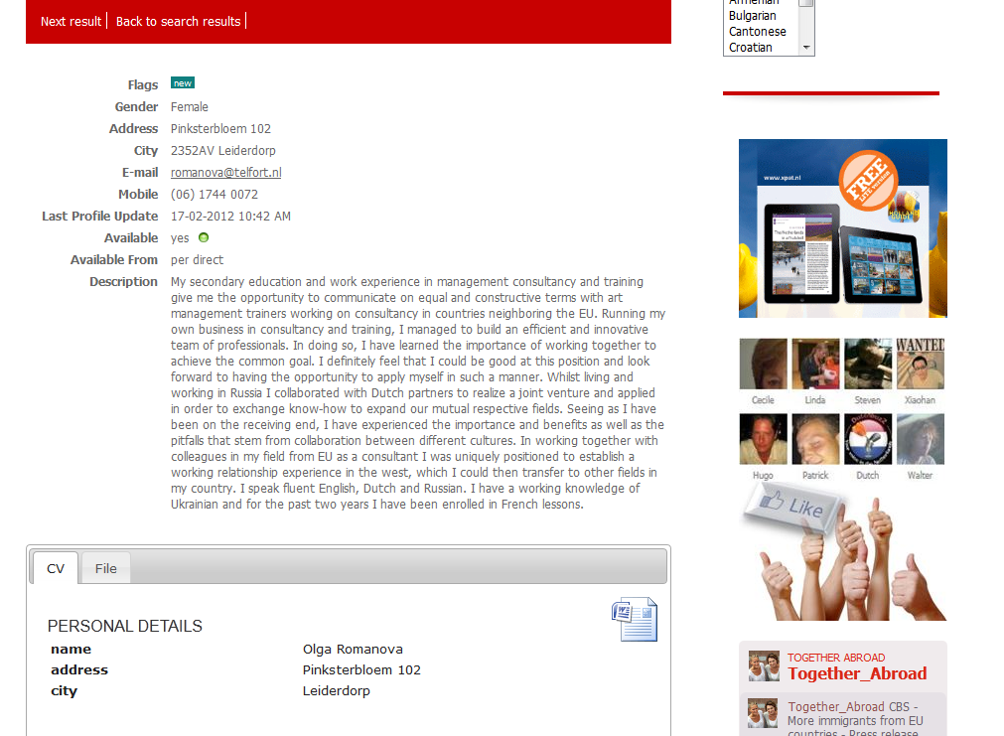
Commercial Jobsites: Job Boards

Slide 22
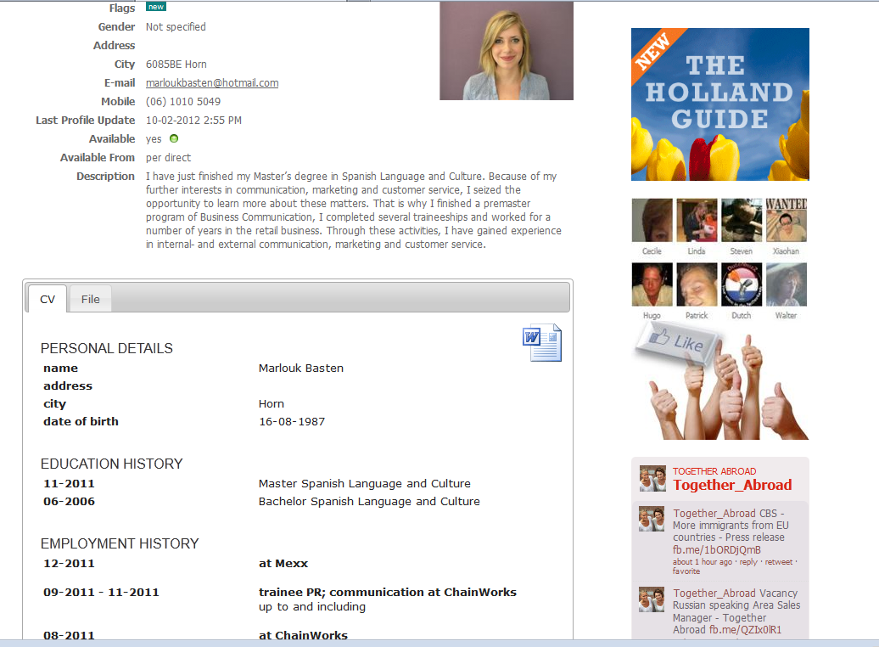
Commercial Jobsites: Job Boards

Slide 23
Commercial Jobsites: Job Boards
CV database
Accessed by agencies and companies
All recruitment agencies should check with you before forwarding your CV!
Put your CV on inactive after finding the job

Slide 24
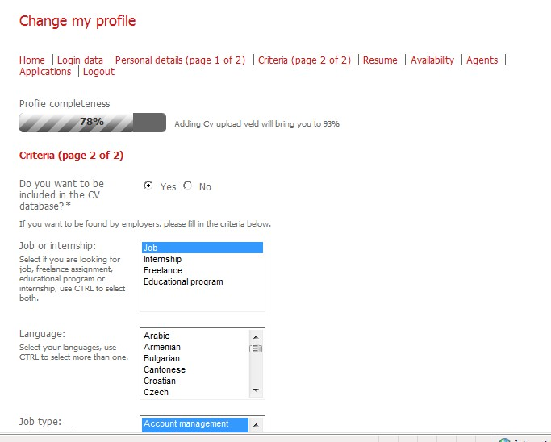
Commercial Jobsites: Job Boards

Slide 25
Commercial Jobsites: Job Boards
Data protection and privacy
Your details should not be shared with anyone else without your permission
You must be asked to confirm with terms and conditions
Website should have privacy policy

Slide 26
Commercial Jobsites: Job Boards
Search agents
Make a separate email address
Set up ‘jobs by email’ account: job agent
SMS service
Tip: make sure you review the criteria on regular basis to avoid missing out suitable jobs!

Slide 27
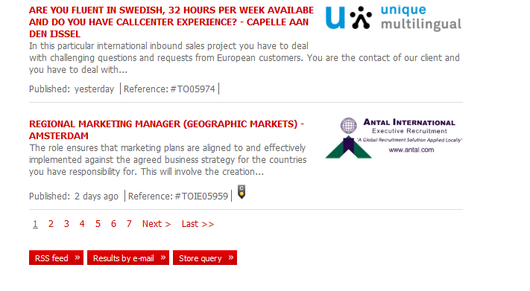
Commercial Jobsites: Job Boards
Search agents

Slide 28
Commercial Jobsites: Job Boards
Student stock | Dutch | www.studentstock.nl
Careerbuilder | Dutch | www.careerbuilder.nl
Monsterboard | Dutch | www.monsterboard.nl
Job news | Dutch | www.jobnews.nl
Craiglist | English | http://amsterdam.craigslist.org/
Career jet | Dutch | www.careerjet.nl
Megajobs | Dutch | www.megajobs.nl
Flex Hunter | Dutch | www.flexhunter.nl
Nationalevacaturebank | Dutch | www.nationalevacaturebank.nl
Xpat jobs | English | www.xpatjobs.nl
Expatriates.com | English | www.expatjobs.com
The White door | English | www.thewhitedoor.com
English language jobs | English | www.englishlanguagejobs.com
Emea Recruitment | English | www.emearecruitment.eu
Jobs in Amsterdam | English | www.jobinamsterdam.com
eFinancial careers | Dutch | http://en.efinancialcareers.nl
Stepstone | Dutch | www.stepstone.nl
Careers in Holland | English | www.careersinholland.com
Top language jobs | Engish | www.toplanguagejobs.nl

Slide 29



Commercial Jobsites: Job Boards
RSS Job feeds
‘Really Simple syndication’ or ‘Rich Site Summary’
Not required to register email address
RSS job search feed:
When a job is posted which matches your criteria a message is sent to you
Publishes content directly to subscriber
To receive: RSS reader
Browser Internet Explorer 7/ 8 has a built in RSS reader

Slide 30
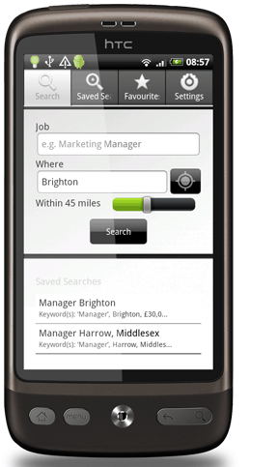

Commercial Jobsites: Job Boards

Slide 31

Job Search Engines
Justlanded
Njobs
Jooble
Jobrapido
Simplyhired
Indeed
Jobsafary
Mitula
Zoekmijnbaan

Slide 32
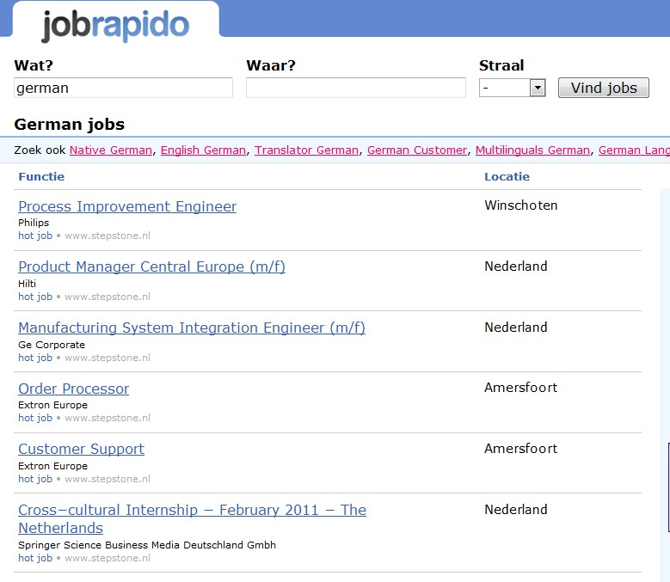
Job search engines

Slide 33
Search engines
How does it work?
30-35 % are listed
software: spiders or robots
Search engines:
Google
AOL
MSN
Lycos
Ask
Yahoo!
Etc.
.

Slide 34
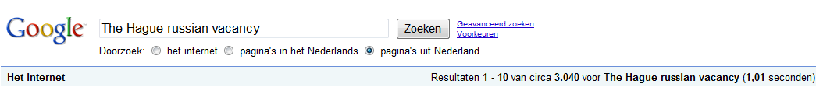
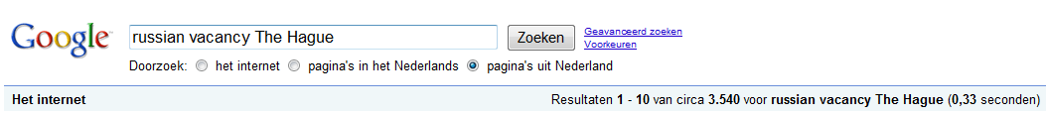
Search engines
Return search results based on ALL the words you use in search terms.
The order can affect the search results:
Tip: Use 2 or more words in your search term. Try changing the order of words to see different results!
Notes:
aap

Slide 35
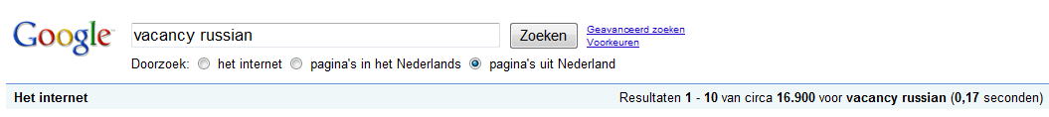
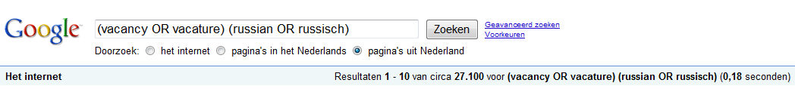
Create your own search queries:
Create your own search queries:
Search engines
Boolean logic
Create your own search queries:
Example 1
Example 2
Notes:
aap

Slide 36
Search engines
Search engine Commands
Commands always with CAPITALS
Notes:
aap

Slide 37
Online networking
Forums
Leforum.nl,Iamexpat, justlanded, xpatmedia, dutch daily news, etc
Blogs
Social networks: Linkedin, Facebook, My Space, Hyves, Youtube, Marktplaats
Publish your CV on your server, website, social network site, blog!!!!!!!!!!!!!!!!!!!!!
English CV/ resume marketing communications professional’

Slide 38
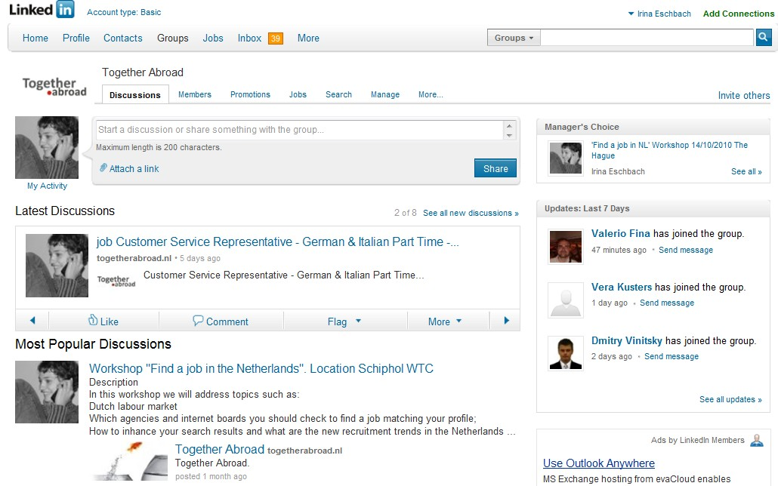
Online networking

Slide 39
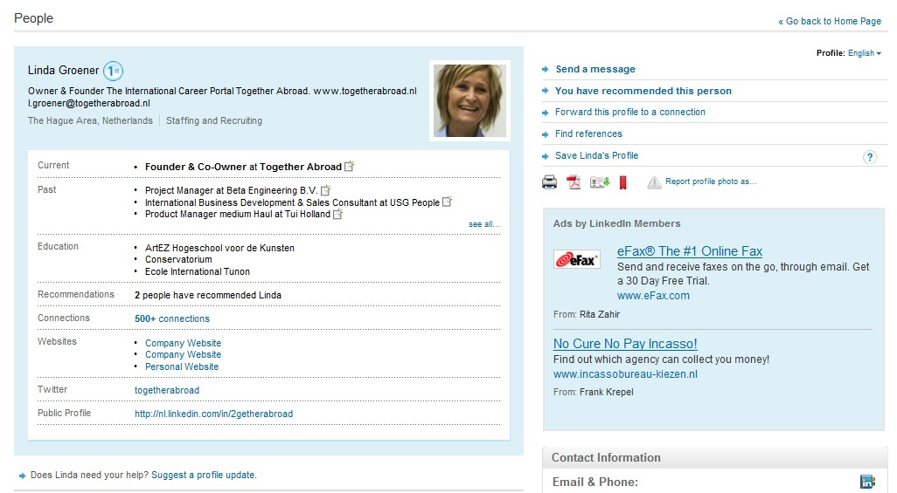

Online networking

Slide 40
CV
Personal information
Full name
Contact details (Skype, Linkedin..)
Date of birth
Nationality
Work permit
Marital status
Photo
Personal profile
Mention your goal and your skills:
Pro-active
Organized
Eyes for details
Education
University
Schools
Courses

Slide 41
CV
Work experience
Languages
English native
German advanced
Dutch beginner

Slide 42
CV
Computer skills
Ms Word, Excel, Powerpoint, SAP, Photoshop, etc.
Achievements
School awards, Work awards, etc
Hobbies
“Before applying for a job take time to look at the job description again to see if your CV matches the keywords and phrases that the employers and recruitment agencies are looking for! Make sure the keywords appear in your CV!...”

Slide 43
CV and cover letter
‘Cover letter is an integral part of your job application. It should refer to your present and future plans, showing your prospective employers what you want to do now and what you will do for them in the future’.
Brief self introduction
Short description of education, skills and other relevant info
Closing indicating your contact details
Use key words!

Slide 44
Career counselling
Career development
Job analysis
List of companies
Search channels (job boards, recruitment agencies)
Creating search agents and RSS feeds (for Dutch boards and agencies)
CV optimalisation
Motivation letters
Interview training (one on one)
IRO (individual reintegration agreement)

Slide 45
THANK YOU FOR YOUR ATTENTION!
GOOD LUCK IN YOUR SEARCH FOR JOBS!
Together Abroad
Notes:
aap

