Slide 1

How to get a job in NL
Notes:
aap

Slide 2
Content
Employment market
Where to search for jobs
How to search/ Social media recruitment trends
Questions
Notes:
aap

Slide 3
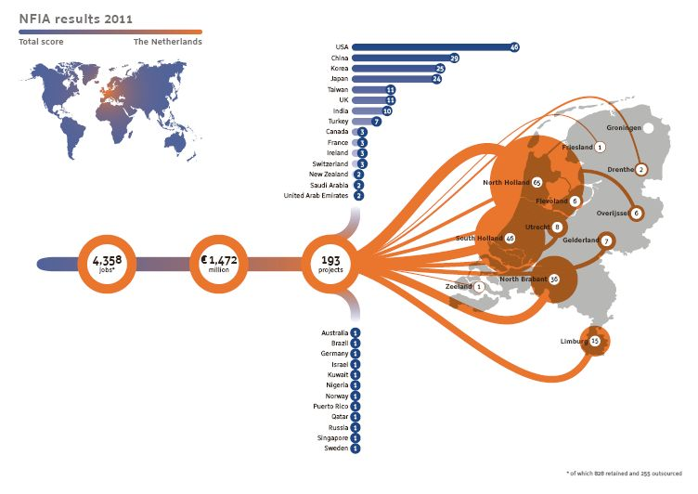
Employment market
Notes:
aap

Slide 4
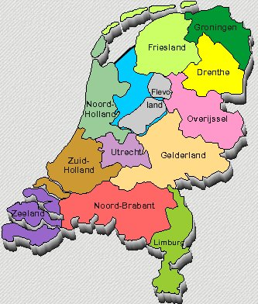
Employment market
Regional Profiles
Nothern Netherlands
East Netherlands
Province of Flevorland
Province of Utrecht
North Holland North
Amsterdam Metropolitan Area
Port of Amsterdam
West Holland
City of Rotterdam
Province of Zeeland
Province of North Brabant
Province of Limburg
Notes:
aap

Slide 5
Employment market
Amsterdam port area
The Amsterdam port area is one of the world’s key international logistics hubs. It ranks as the 4th port in North Western Europe. The strategic and central location in Europe makes the port easy to reach and ensures excellent connections to all the major European markets.
Key figures / industries
Annually 73 million tons of dry and liquid bulk, general cargo and containers are handled, stored, transhipped and processed in the port area. From cocoa beans to coal, from paper to oil. A multipurpose port, handling all types of commodities.
Foreign companies
Starbucks, Nissan, BP, Hitachi, Oiltanking, Cargill, EDF Energy, PPG Industries, Archer Daniels Midland Company (ADM), DSV
Notes:
aap

Slide 6
Employment market
Amsterdam Metropolitan Area
Amsterdam, the capital of the Netherlands is one of Europe’s most international cities. It is ranked as the third European capital ‘best centers for commerce’ *.
Key industries/ regional strengths
Most businesses are active in ICT (content and services), Finance and business services, Creative sector (advertising, gaming and fashion), Logistics, Perishables, Aerospace and Life sciences.35% of its labour force is directly or indirectly employed by foreign companies.
Amsterdam’s
Foreign companies
More than 1,800 foreign companies like Adidas, Hitachi, LG, Mattel, General Electric, Hewlett Packard and many international headquarters of Dutch firms like Philips, Heineken, Ahold, Akzo Nobel and ING are located in the Amsterdam Metropolitan Area.
Notes:
aap

Slide 7
Employment market
More than 6,300 foreign companies have established over 8,800 operations in the Netherlands.
2011:
Amsterdam Metropolitan Area:
118 new international companies
employment for 1,231 people
West Holland:
32 international companies
employment for 766 people
Notes:
aap

Slide 8
Where to search
Company careers sites
Recruitment agencies
Job boards
Job search engines
Online networking

Slide 9
Company career sites
Bizdirectories and company spot sites
World trade centers
Investment companies
Chambers of commerce
Expat centers

Slide 10
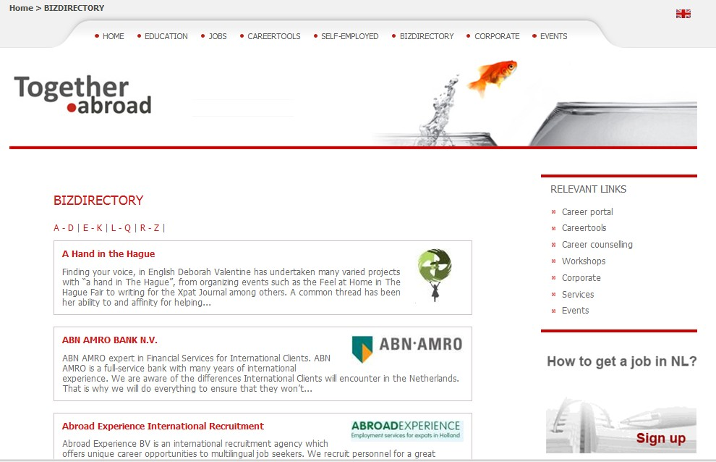
Company career sites

Slide 11
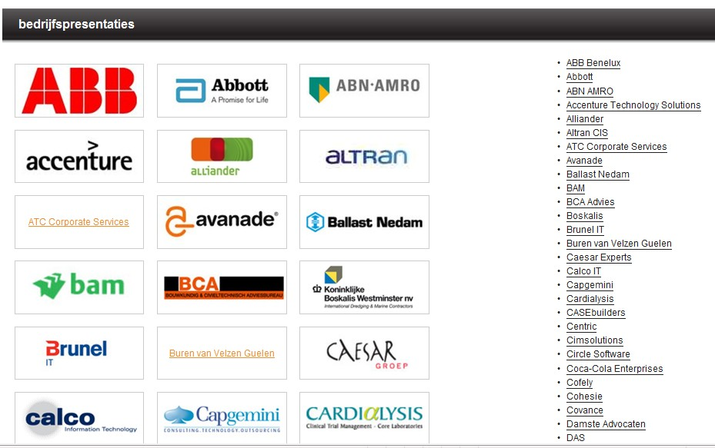
Company career sites
www.kiesjewerkgever.nl
Notes:
aap

Slide 12
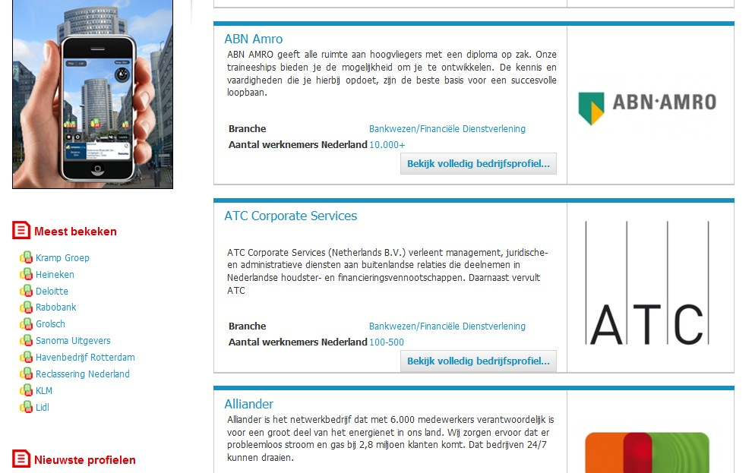
Company career sites
www.companyspot.nl
Notes:
aap

Slide 13
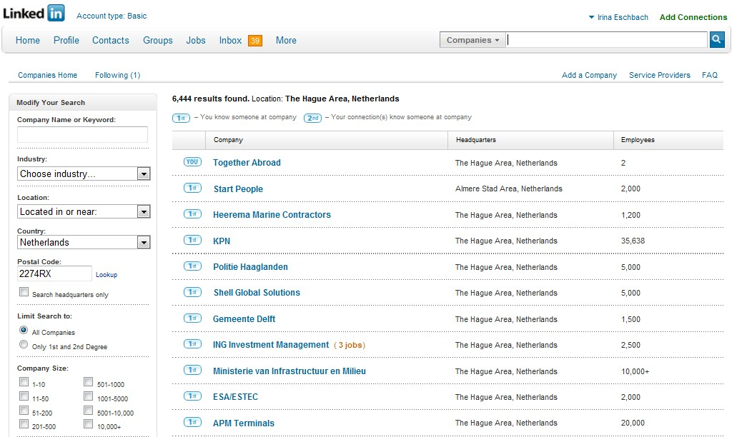
Company career sites
www.linkedin.com
Notes:
aap

Slide 14
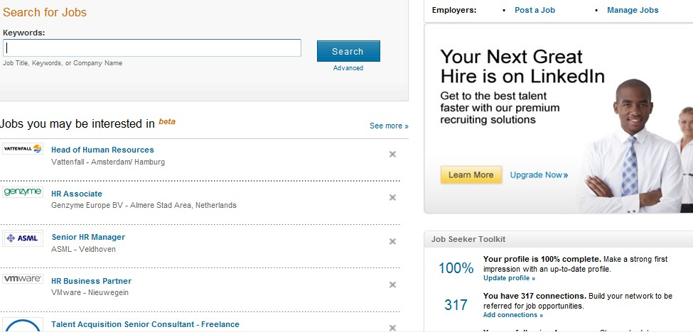
Company career sites
www.linkedin.com
Notes:
aap

Slide 15
Recruitment agencies

Slide 16
Recruitment agencies

Slide 17
Commercial Jobsites: Job Boards
General /niche
CV database
Data protection and privacy
Search agents
RSS Job feeds

Slide 18
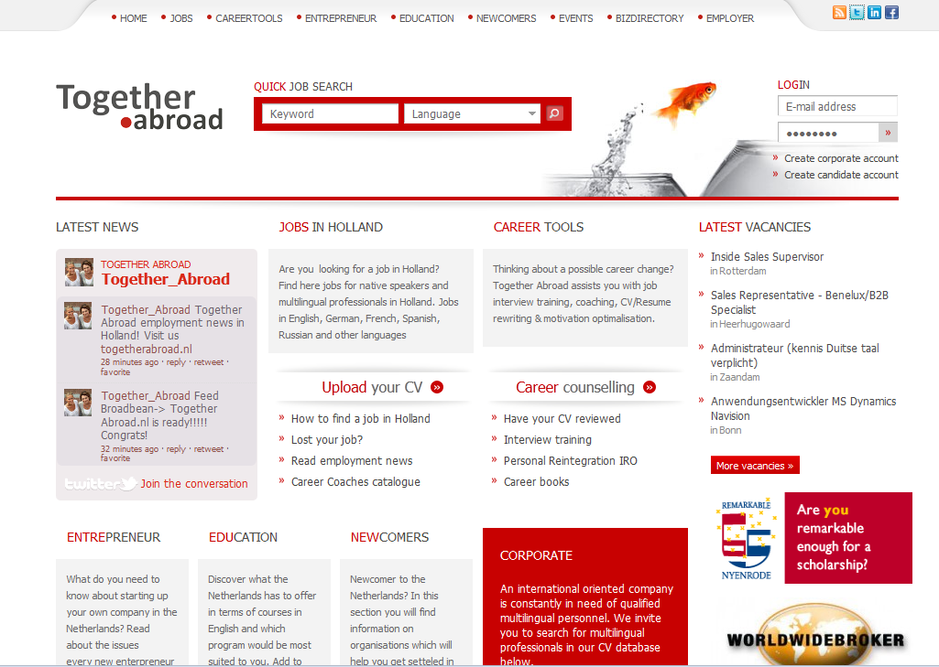
Commercial Jobsites: Job Boards

Slide 19
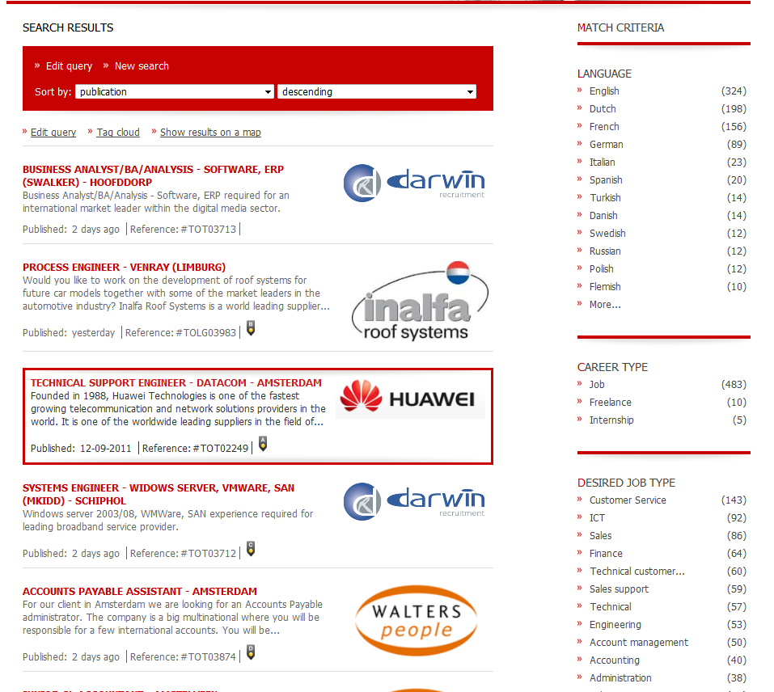
Commercial Jobsites: Job Boards

Slide 20
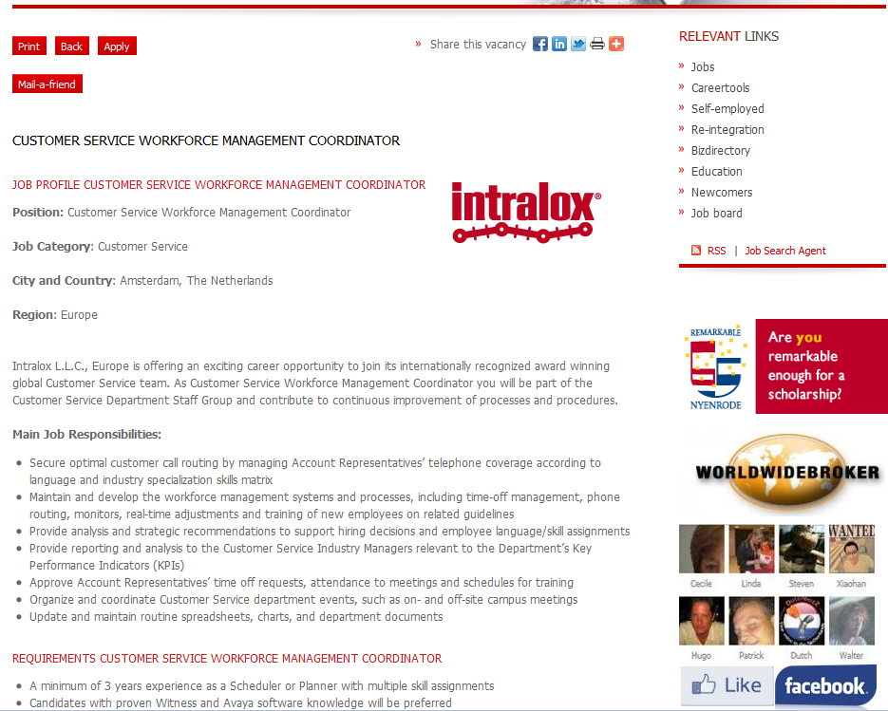
Commercial Jobsites: Job Boards

Slide 21
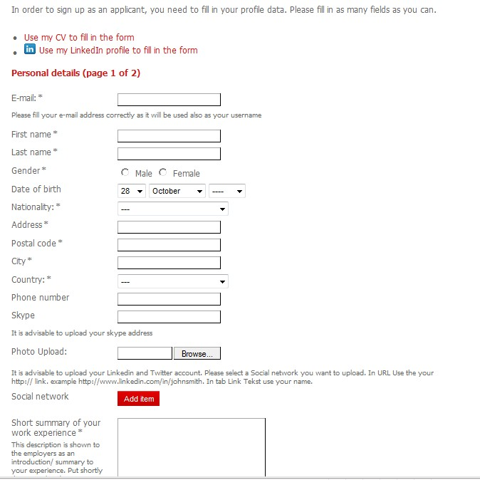
Commercial Jobsites: Job Boards

Slide 22
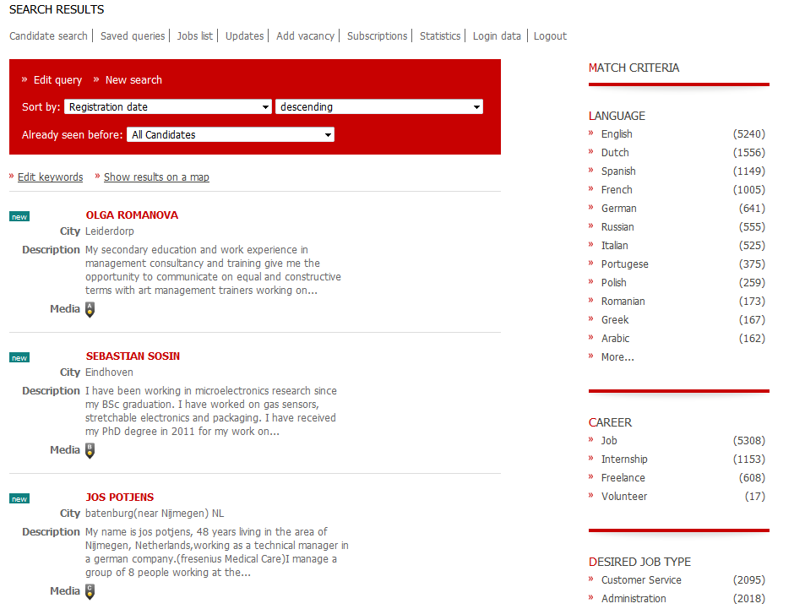
Commercial Jobsites: Job Boards

Slide 23
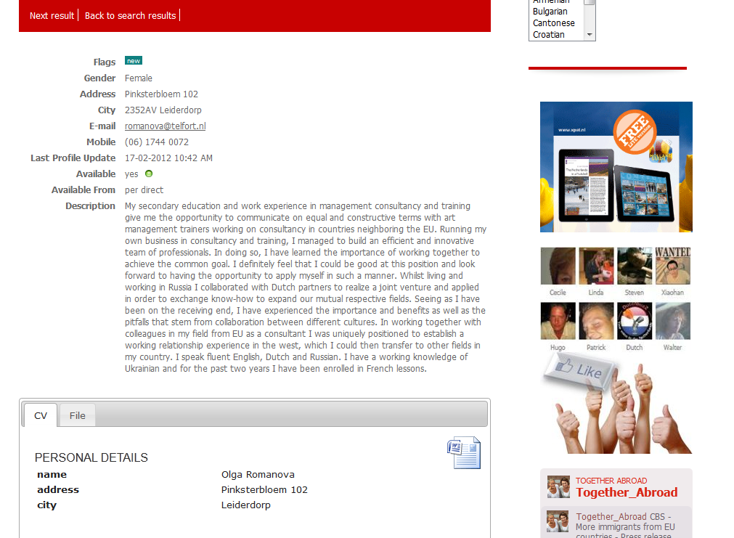
Commercial Jobsites: Job Boards

Slide 24
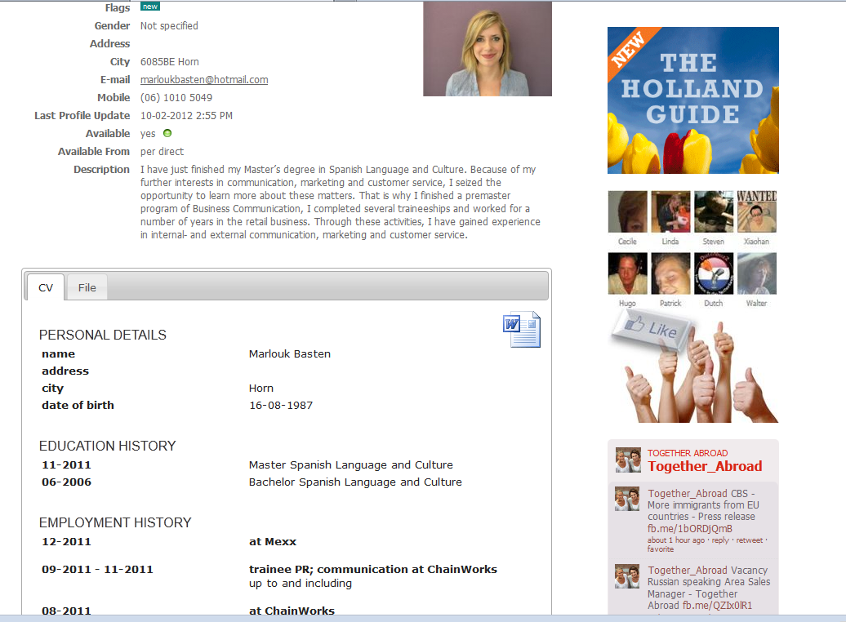
Commercial Jobsites: Job Boards

Slide 25
Commercial Jobsites: Job Boards
CV database
Accessed by agencies and companies
All recruitment agencies should check with you before forwarding your CV!
Put your CV on inactive after finding the job

Slide 26
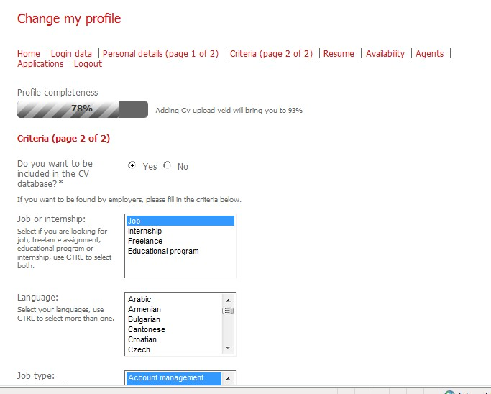
Commercial Jobsites: Job Boards

Slide 27
Commercial Jobsites: Job Boards
Data protection and privacy
Your details should not be shared with anyone else without your permission
You must be asked to confirm with terms and conditions
Website should have privacy policy

Slide 28
Commercial Jobsites: Job Boards
Search agents
Make a separate email address
Set up ‘jobs by email’ account: job agent
SMS service
Tip: make sure you review the criteria on regular basis to avoid missing out suitable jobs!

Slide 29
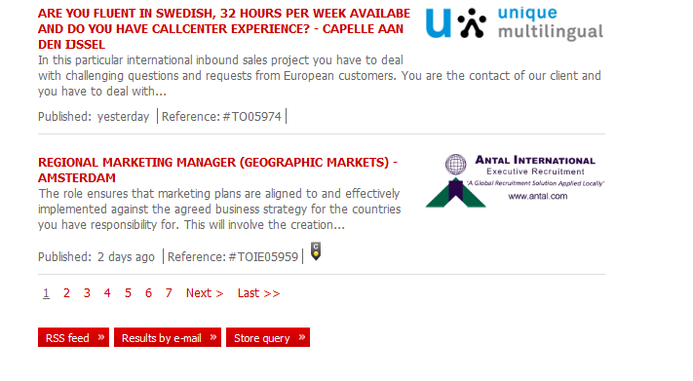
Commercial Jobsites: Job Boards
Search agents

Slide 30
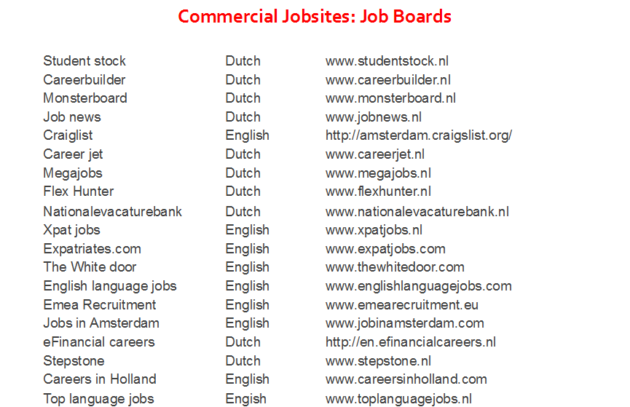

Slide 31



Commercial Jobsites: Job Boards
RSS Job feeds
‘Really Simple syndication’ or ‘Rich Site Summary’
Not required to register email address
RSS job search feed:
When a job is posted which matches your criteria a message is sent to you
Publishes content directly to subscriber
To receive: RSS reader
Browser Internet Explorer 7/ 8 has a built in RSS reader

Slide 32
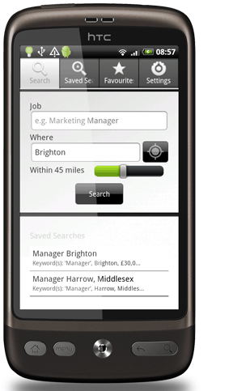
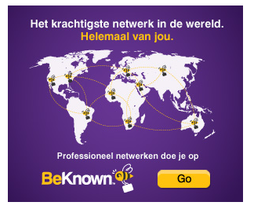
Commercial Jobsites: Job Boards

Slide 33

Job Search Engines
Justlanded
Njobs
Jooble
Jobrapido
Simplyhired
Indeed
Jobsafary
Mitula
Zoekmijnbaan

Slide 34
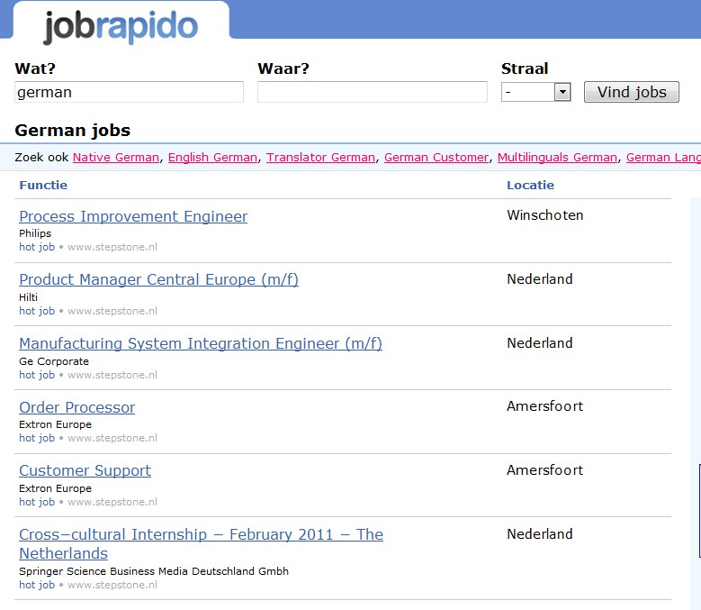
Job search engines

Slide 35
Search engines
How does it work?
30-35 % are listed
software: spiders or robots
Search engines:
Google
AOL
MSN
Lycos
Ask
Yahoo!
Etc.
.

Slide 36
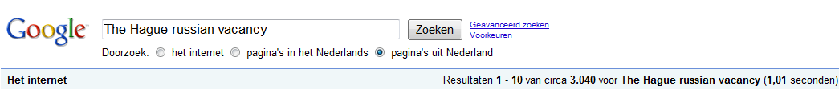
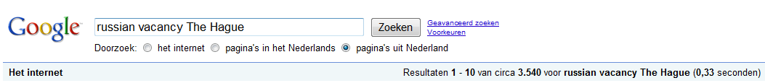
Search engines
Return search results based on ALL the words you use in search terms.
The order can affect the search results:
Tip: Use 2 or more words in your search term. Try changing the order of words to see different results!
Notes:
aap

Slide 37
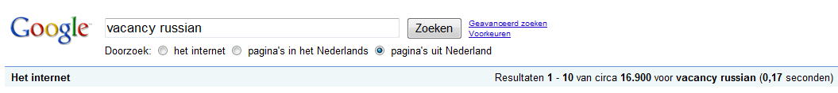
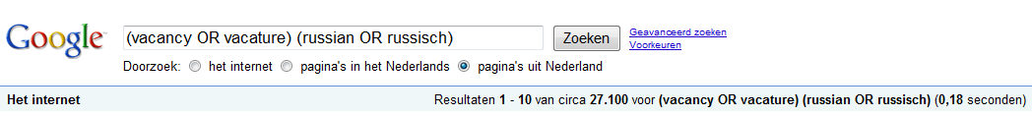
Create your own search queries:
Create your own search queries:
Search engines
Boolean logic
Create your own search queries:
Example 1
Example 2
Notes:
aap

Slide 38
Search engines
Search engine Commands
Commands always with CAPITALS
Notes:
aap

Slide 39
Online networking
Forums
Leforum.nl,Iamexpat, justlanded, xpatmedia, dutch daily news, etc
Blogs
Social networks: Linkedin, Facebook, My Space, Hyves, Youtube, Marktplaats
Publish your CV on your server, website, social network site, blog!!!!!!!!!!!!!!!!!!!!!
English CV/ resume marketing communications professional’

Slide 40
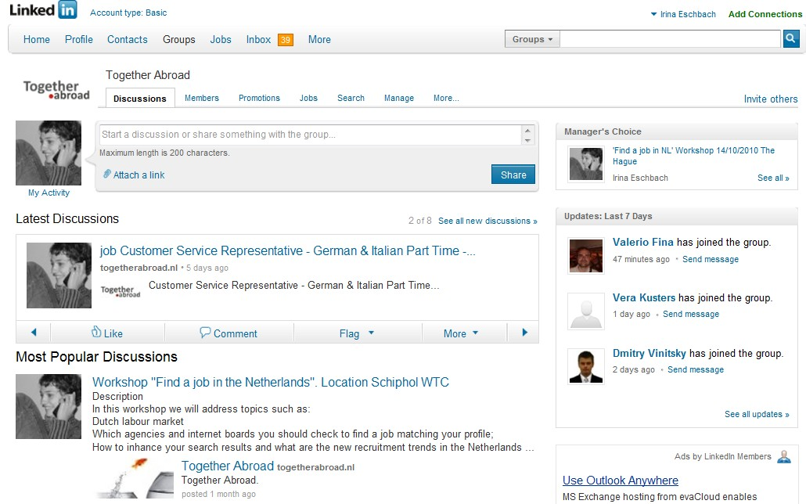
Online networking

Slide 41
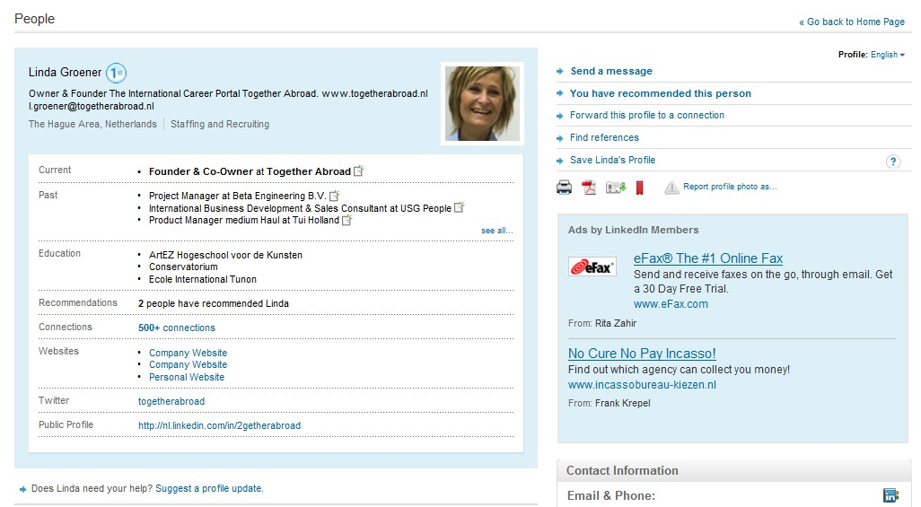

Online networking

Slide 42
CV
Personal information
Full name
Contact details (Skype, Linkedin..)
Date of birth
Nationality
Work permit
Marital status
Photo
Personal profile
Mention your goal and your skills:
Pro-active
Organized
Eyes for details
Education
University
Schools
Courses

Slide 43
CV
Work experience
Languages
English native
German advanced
Dutch beginner

Slide 44
CV
Computer skills
Ms Word, Excel, Powerpoint, SAP, Photoshop, etc.
Achievements
School awards, Work awards, etc
Hobbies
“Before applying for a job take time to look at the job description again to see if your CV matches the keywords and phrases that the employers and recruitment agencies are looking for! Make sure the keywords appear in your CV!...”

Slide 45
CV and cover letter
‘Cover letter is an integral part of your job application. It should refer to your present and future plans, showing your prospective employers what you want to do now and what you will do for them in the future’.
Brief self introduction
Short description of education, skills and other relevant info
Closing indicating your contact details
Use key words!

Slide 46
Career counselling
Career development
Job analysis
List of companies
Search channels (job boards, recruitment agencies)
Creating search agents and RSS feeds (for Dutch boards and agencies)
CV optimalisation
Motivation letters
Interview training (one on one)
IRO (individual reintegration agreement)

Slide 47
THANK YOU FOR YOUR ATTENTION!
GOOD LUCK IN YOUR SEARCH FOR JOBS!
Together Abroad
Notes:
aap

